Slide 1
DETECTING PNEUMONIA IN CHEST X-RAY IMAGES USING GENERATIVE ARTIFICIAL INTELLIGENCE
PRESENTED BY
PRIYASHAKHI.R
REG NO:912321104033
III RD YEAR-CSE
SACS M.A.V.M.M. ENGINEERING COLLEGE
ALAGAR KOVIL,MADURAI.

Slide 2
AGENDA
PROBLEM STATEMENT
PROPOSED SYSTEM/SOLUTION
SYSTEM DEVELOPMENT APPROACHES
ALGORITHM AND DEPLOYMENT
RESULT
REFERENCES
CONCLUSION

Slide 3
PROBLEM STATEMENT
Pneumonia remains a significant global health concern, with early detection crucial for effective treatment and patient outcomes. Traditional methods of pneumonia diagnosis, particularly through chest X-ray (CXR) analysis, are time-consuming and reliant on expert interpretation. Generative Artificial Intelligence (AI) algorithms offer a promising solution for automating pneumonia detection from CXR images.The problem statement revolves around developing and implementing a robust generative AI algorithm capable of accurately identifying pneumonia from chest X-ray images.

Slide 4
PROPOSED SYSTEM/SOLUTION
DATA COLLECTION AND PREPROCESSING
GENERATIVE ADVERSARIAL NETWORK ARCHITECTURE
TRAINING PROCESS
EVALUATION AND VALIDATION
INTEGRATION WITH DIAGNOSTIC SYSTEM
ETHICAL CONSIDERATIONS
REGULATORY COMPLIANCE

Slide 5
PROPOSED SYSTEM/SOLUTION(Contd...)
1.Data Collection and Preprocessing:
Gather a large dataset of chest X-ray images with labels indicating the presence or absence of pneumonia.Preprocess the images to standardize size, orientation, and contrast, ensuring uniformity across the dataset.
2.Gnerative Adversarial Network (GAN) Architecture:
Utilize a GAN framework consisting of two neural networks: a generator and a discriminator.The generator generates synthetic chest X-ray images resembling those with pneumonia.
3.Training Process:
Train the GAN on the collected dataset, allowing the generator to learn the underlying patterns of pneumonia in chest X-rays.Employ techniques such as transfer learning if pretrained models are available to enhance efficiency and performance.

Slide 6
PROPOSED SYSTEM/SOLUTION(Contd...)
4.Evaluation and Validation:
Assess the performance of the trained GAN using evaluation metrics such as accuracy, precision, recall, and F1-score.
5.Integration with Diagnostic System:
Integrate the trained GAN into a diagnostic system for pneumonia detection.Develop an intuitive user interface for clinicians to input chest X-ray images and receive automated predictions.
6.Ethical Considerations:
Ensure the responsible use of AI technology by considering potential biases and ensuring transparency in decision-making processes.
7.Regulatory Compliance:
Adhere to relevant regulations and standards governing the use of AI in medical diagnosis, such as FDA guidelines in the United States.

Slide 7
SYSTEM DEVELOPMENT APPROACHES
Data Collection:
Gather a large dataset of chest X-ray images labeled with pneumonia and non-pneumonia cases. Ensure the dataset is diverse and representative of different demographics and conditions.
Preprocessing:
Clean and preprocess the X-ray images to standardize their size, orientation, and contrast. This step may also involve noise reduction and image enhancement techniques to improve the quality of the images.
Generative Algorithm Selection:
Choose a suitable generative artificial intelligence algorithm for generating synthetic X-ray images. This could include approaches such as Generative Adversarial Networks (GANs), Variational Autoencoders (VAEs), or other generative models

Slide 8
SYSTEM DEVELOPMENT APPROACHES(Contd...)
Validation and Optimization:
Validate the performance of the pneumonia detection model using appropriate evaluation metrics and techniques. Fine-tune needed to optimize its performance on a validation dataset.
Testing and Evaluation:
Evaluate the final pneumonia detection system on a separate test dataset to assess its performance, sensitivity, specificity, and overall accuracy.
Deployment and Integration:
Deploy the trained pneumonia detection system in a clinical or healthcare setting, integrating it with existing medical imaging systems if necessary.
Continuous Monitoring and Improvement:
Monitor the performance of the deployed system over time and implement updates or improvements as needed based on feedback and new data.

Slide 9
ALGORITHM AND DEPLOYMENT
ALGORITHM:
Step:1
Acquire a dataset of chest X-ray images labeled with pneumonia-positive and pneumonia-negative cases.
Step:2
Train a generative model, like a Generative Adversarial Network (GAN) or Variational Autoencoder (VAE), using the dataset to generate synthetic chest X-ray images.
Step:3
Augment the original dataset with the synthetic images to increase diversity.
Step:4
Develop and train a classification model, such as a Convolutional Neural Network (CNN), on the augmented dataset to classify X-ray images as pneumonia-positive or pneumonia-negative.

Slide 10
ALGORITHM (Contd...)
Step:5
Validate the performance of the classification model using a separate validation dataset and optimize its parameters if necessary.
Step:6
Evaluate the final pneumonia detection algorithm on a separate test dataset to assess its accuracy and generalization ability.
Step:7
Deploy the trained algorithm in a clinical or healthcare setting for real-world pneumonia detection applications.
Step:8
Monitor the algorithm's performance over time and update it as needed based on feedback and new data.

Slide 11
ALGORITHM AND DEPLOYMENT
DEPLOYMENT:
Deployment of a pneumonia detection system using a generative artificial intelligence (AI) algorithm involves several crucial steps to ensure its successful implementation in real-world healthcare settings.
Initially, the system undergoes rigorous training using a diverse dataset of chest X-ray images labeled with pneumonia presence or absence.
This training process enables the AI algorithm to learn the intricate patterns and features associated with pneumonia in X-ray images.
Deployment of a pneumonia detection system using a generative artificial intelligence (AI) algorithm involves several crucial steps to ensure its successful implementation in real-world healthcare settings.

Slide 12
DEPLOYMENT(contd...)
To enhance user experience and accessibility, a user-friendly interface is developed, allowing healthcare professionals to upload chest X-ray images and receive real-time predictions on pneumonia presence.
This interface is designed to be intuitive and easy to navigate, enabling efficient interaction with the deployed system.
Training and support are provided to healthcare professionals utilizing the system to ensure they can effectively leverage its capabilities for pneumonia detection in chest X-ray images.
This includes comprehensive training sessions, ongoing support, and access to resources for continued learning and optimization of the system's usage.

Slide 13
DATASET STATE
Dataset for Detecting Pneumonia in chest x-ray image using generative artificial intelligence algorithm.
https://www.kaggle.com/datasets/paultimothymooney/chest-xray-pneumonia

Slide 14
IMPLEMENTATION
import numpy as np
import pandas as pd
print(os.path.join(dirname, filename))
import osfrom PIL
import Imageimport itertools
import cv2
import matplotlib.pyplot as plt
import seaborn as snssns.set_style('darkgrid')
from sklearn.model_selection
import train_test_split
from sklearn.metrics
import confusion_matrix,
classification_reportimport tensorflow as tf
from tensorflow
import kerasfrom tensorflow.keras.models
import Sequentialfrom tensorflow.keras.layers
import Conv2D, MaxPooling2D, Flatten, Dropout, Dense, Activation, BatchNormalization
from tensorflow.keras
import regularizersfrom tensorflow.keras.optimizers
import Adam, Adamax
from tensorflow.keras.preprocessing.image
import ImageDataGenerator
import warningswarnings.filterwarnings('ignore')
print('Modules Loaded')
train_data_path = '/kaggle/input/chest-xray-pneumonia/chest_xray/train‘
filepaths = []
labels = []
folds = os.listdir(train_data_path)
for fold in folds:
foldpath = os.path.join(train_data_path, fold)
filelist = os.listdir(foldpath)
for file in filelist:
fpath = os.path.join(foldpath, file)
filepaths.append(fpath)
labels.append(fold)
FSeries = pd.Series(filepaths, name='filepaths')
LSeries = pd.Series(labels, name='label')
df = pd.concat([FSeries, LSeries], axis=1)
Datasetvalid_data_dir = '/kaggle/input/chest-xray-pneumonia/chest_xray/val‘
filepaths = []
labels = []
folds = os.listdir(valid_data_dir)
for fold in folds:
foldpath = os.path.join(valid_data_dir, fold)
filelist = os.listdir(foldpath)
for file in filelist:
fpath = os.path.join(foldpath, file)

Slide 15
IMPLEMENTATION(Contd...)
FSeries = pd.Series(filepaths, name='filepaths')
LSeries = pd.Series(labels, name='label')
test = pd.concat([FSeries, LSeries], axis=1)
validtesttrain_df, dummy_
df = train_test_split(df, train_size=0.8, shuffle=True, random_state=42)
valid_df, test_df = train_test_split(dummy_df, train_size=0.5, shuffle=True, random_state=42)
batch_size = 64img_size = (224, 224)
tr_gen = ImageDataGenerator()
ts_gen = ImageDataGenerator()
val_gen = ImageDataGenerator()
train_gen = tr_gen.flow_
from_dataframe(train_df, x_col='filepaths', y_col='label', target_size=img_size, class_mode='categorical', color_mode='rgb', shuffle=True, batch_size=batch_size)
valid_gen = val_gen.flow_
from_dataframe(valid_df, x_col='filepaths', y_col='label', target_size=img_size, class_mode='categorical', color_mode='rgb',
shuffle=True, batch_size=batch_size)
test_gen = ts_gen.flow
_from_dataframe(test_df, x_col='filepaths', y_col='label', target_size=img_size, class_mode='categorical', color_mode='rgb', shuffle=False, batch_size=batch_siz
def attention_block(input_tensor, filters)
conv1 = Conv2D(filters, (3, 3), padding='same')(input_tensor)
conv1 = Activation('relu')(conv1)
conv2 = Conv2D(filters, (3, 3), padding='same')(conv1)
conv2 = Activation('relu')(conv2)
attn = Add()([conv1, conv2])
attn = Activation('relu')(attn)
attn = Conv2D(1, (1, 1), padding='same')(attn)
attn = Activation('softmax')(attn)
output_tensor = Multiply()([input_tensor, attn])
return output_tensor
modelinput_tensor = keras.Input(shape=(224, 224, 3))
x = attention_block(input_tensor, 64)
x = Conv2D(128, (3, 3), activation='relu', padding='same')(x)x = MaxPooling2D((2, 2))(x)
x = attention_block(x, 128)
x = Conv2D(256, (3, 3), activation='relu', padding='same')(x)
X=MaxPooling2D((2, 2))(x)
x = attention_block(x, 256)
x = Flatten()(x)x = Dense(128, activation='relu')(x)
layerx = Dense(64, activation)
layeroutput_tensor = Dense(2, activation='softmax')(x)
model = keras.Model(input_tensor, output_tensor)

Slide 16
IMPLEMENTATION(Contd...)
print(f'Test loss: {loss}, Test accuracy: {accuracy}')
tr_acc = history.history['accuracy']
tr_loss = history.history['loss']
val_acc = history.history['val_accuracy']
val_loss = history.history['val_loss']
index_loss = np.argmin(val_loss)
val_lowest = val_loss[index_loss]
index_acc = np.argmax(val_acc)
acc_highest = val_acc[index_acc]
Epochs = [i+1 for i in range(len(tr_acc))]
loss_label = f'best epoch= {str(index_loss + 1)}‘
acc_label = f'best epoch= {str(index_acc + 1)
training historyplt.figure(figsize= (20, 8))
plt.style.use('fivethirtyeight')
plt.subplot(1, 2, 1)
plt.plot(Epochs, tr_loss, 'r', label= 'Training loss')
plt.plot(Epochs, val_loss, 'g', label= 'Validation loss')
plt.scatter(index_loss + 1, val_lowest, s= 150, c= 'blue', label= loss_label)
plt.title('Training and Validation Loss')
plt.xlabel('Epochs')
plt.ylabel('Loss')plt.legend()plt.subplot(1, 2, 2)plt.plot(Epochs, tr_acc, 'r', label= 'Training Accuracy')plt.plot(Epochs, val_acc, 'g', label= 'Validation Accuracy')
plt.scatter(index_acc + 1 , acc_highest, s= 150, c= 'blue', label= acc_label)plt.title('Training and Validation Accuracy‘)
plt.tight_layout
plt.show()
train_score = model.evaluate(train_gen, verbose= 1)
valid_score = model.evaluate(valid_gen, verbose= 1)
test_score = model.evaluate(test_gen, verbose= 1)
print("Train Loss: ", train_score[0])
print("Train Accuracy: ", train_score[1])
print('-' * 20)print("Validation Loss: ", valid_score[0])
print("Validation Accuracy: ", valid_score[1])
print('-' * 20)print("Test Loss: ", test_score[0])
print("Test Accuracy: ", test_score[1])
from sklearn.metrics
import classification_report,
confusion_matrix
pred = model.predict(test_gen)
y_pred_classes = np.argmax(y_pred, axis=1)
labelsy_true = test_gen.class
print("Classification Report:")
print(classification_report(y_true, y_pred_classes))
conf_mat = confusion_matrix(y_true, y_pred_classes)
Matrixplt.figure(figsize=(8, 6))
sns.heatmap(conf_mat, annot=True, fmt='d', cmap='Blues',
xticklabels=test_gen.class_indices.keys(),
yticklabels=test_gen.class_indices.keys())

Slide 17
IMPLEMENTATON(Contd...)
plt.title('Confusion Matrix')
plt.xlabel('Predicted Label')
plt.ylabel('True Label')
plt.show() model.save('/kaggle/working/Classfication_model.h5')
model.summary()
from tensorflow.keras.models
import load_modelfrom PIL Image_labels = ["NORMAL", "PNEUMONIA"]
def preprocess_image(image_path): img = Image.open(image_path)
img = img.resize((224, 224))
img = np.array(img)
img = img / 255.0
img = np.expand_dims(img, axis=-1)
img = np.repeat(img, 3, axis=-1)
img = np.expand_dims(img, axis=1)
return img
def predict_image(model, image_path):
preprocessed_img = preprocess_image(image_path)
prediction = model.predict(preprocessed_img)
return prediction
def get_predicted_class(prediction)
predicted_class_index = np.argmax(prediction)
predicted_class = class_labels[predicted_class_index]
probability = prediction[0][predicted_class_index]
return predicted_class, probability usageimage_path = '/kaggle/input/chest-xray-pneumonia/chest_xray/train/NORMAL/IM-0119-0001.jpeg'prediction = predict_image(loaded_model, image_path)
predicted_class, probability = get_predicted_class(prediction)
print("Predicted Class:", predicted_class)
print("Probability:", probability)

Slide 18
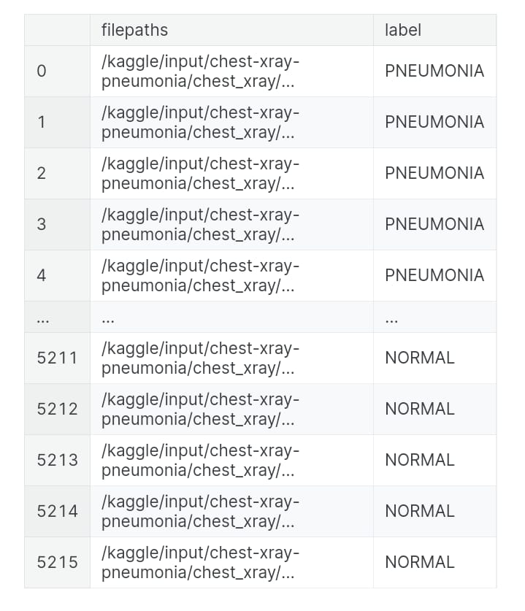
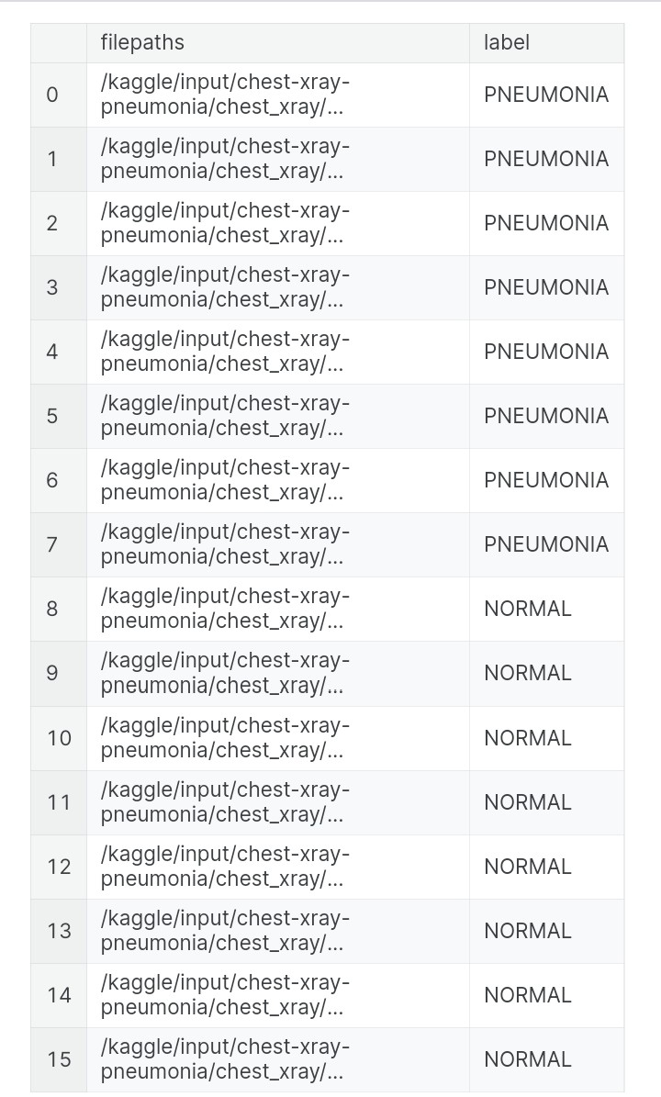
RESULT

Slide 19
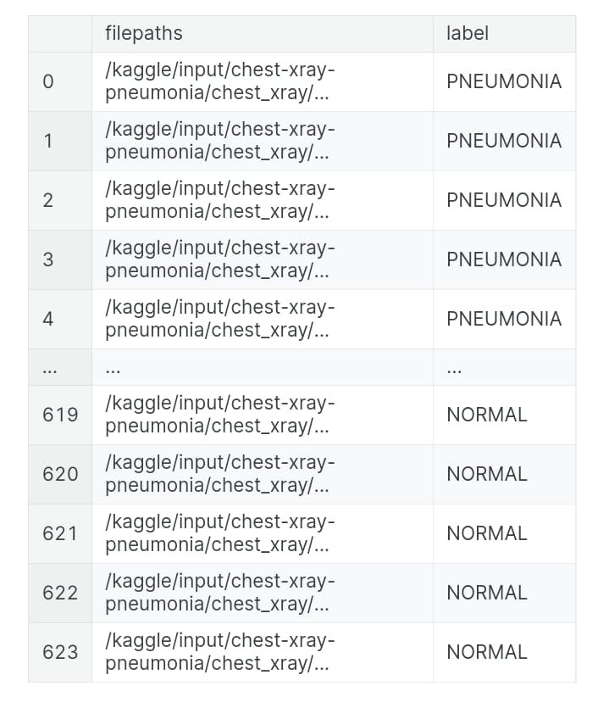
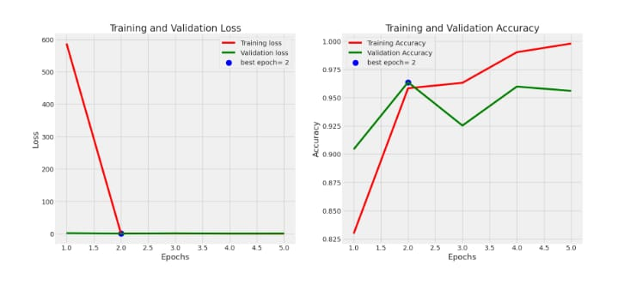
RESULT(Contd...)

Slide 20
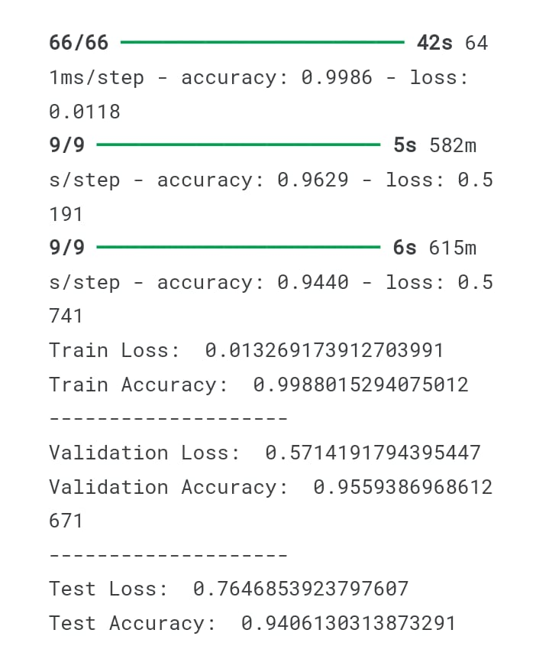
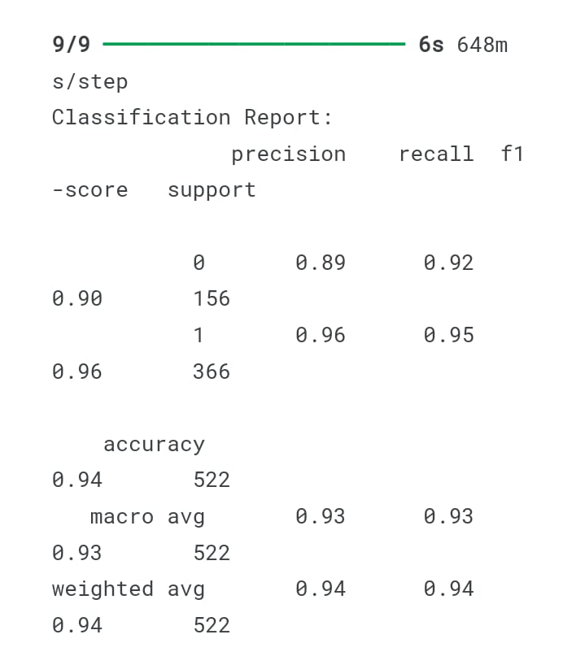
RESULT(Contd...)

Slide 21
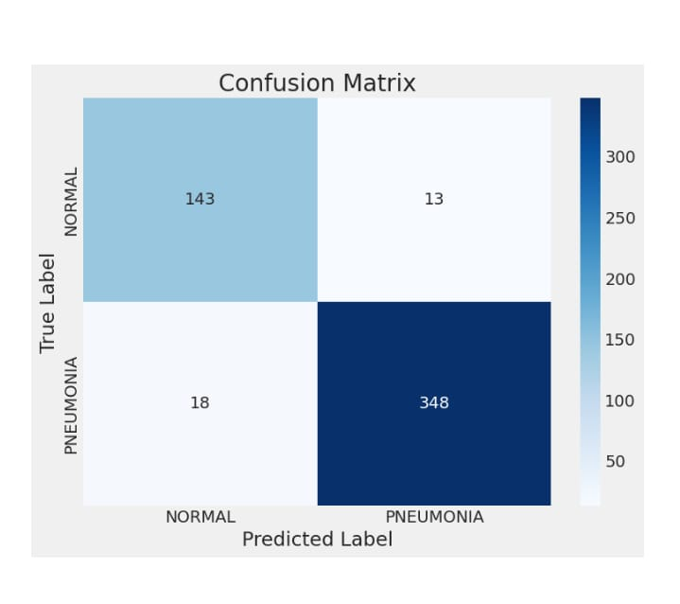
RESULT(Contd...)
Total params: 617,601,230 (2.30 GB)
Trainable params: 205,867,076 (785.32 MB)
Non-trainable params: 0 (0.00 B)
Optimizer params: 411,734,154 (1.53 GB)

Slide 22
REFERENCES
https://numpy.org/
https://pandas.pydata.org/
https://matplotlib.org/
https://seaborn.pydata.org/
https://www.tensorflow.org/

Slide 23
CONCLUSION
The utilization of generative artificial intelligence algorithms for the detection of pneumonia in chest X-ray images presents a promising approach in medical imaging. Through the synthesis of realistic chest X-ray images, these algorithms can augment limited datasets, improving the robustness and accuracy of pneumonia detection models. By harnessing the power of generative algorithms, healthcare practitioners can potentially enhance diagnostic capabilities, leading to earlier detection and intervention for patients. As technology continues to advance, further research and validation will be essential to fully realize the potential of these AI-driven solutions in improving patient outcomes and healthcare efficiency.

Slide 24
THANK YOU!

